Slide 1
Cloud Elevate –Exam Readiness workshop AWS Certified Developer - Associate
Developing and Deepening
Cloud skills @ATCI

Slide 2
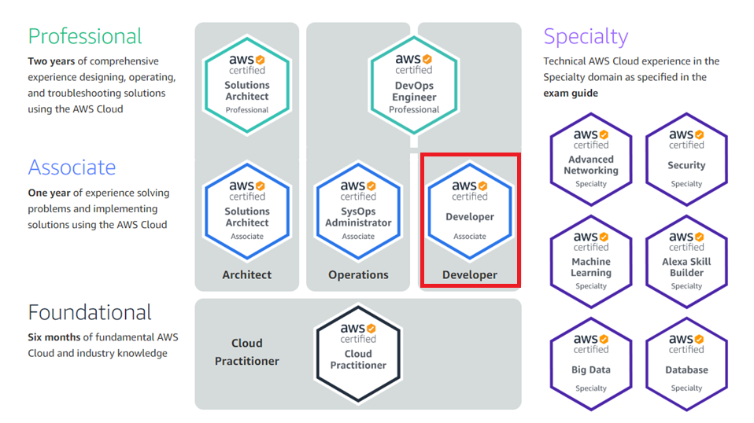
AWS CERTIFICATION PATH
https://aws.amazon.com/certification/
2

Slide 3
AWS Developer - associate
AWS Developer - Associate Exam Guide (Exam Blueprint)
Domain | % of Exam
A.Deployment | 22%
B.Security | 26%
C.Development with AWS | 30%
D.Refactoring | 10%
5: Monitoring and Troubleshooting | 12%
Total | 100%

Slide 4
Deployment– 22%
Objectives
Deploy written code in AWS using CI/CD pipelines, processes, and patterns
Deploy applications using AWS Elastic Beanstalk
Prepare the application package to be deployed to AWS
Deploy serverless applications

Slide 5
Deployment – 22%
Key AWS Services
Developer Tools to implement CI/CD
AWS Elastic Beanstalk
AWS CloudFormation
Serverless Architecture

Slide 6
Understanding CI & CD
Continuous Delivery / Deployment
Check in code
Build code
Deploy
Test code
Monitor
Develop Code
Continuous integration

Slide 7
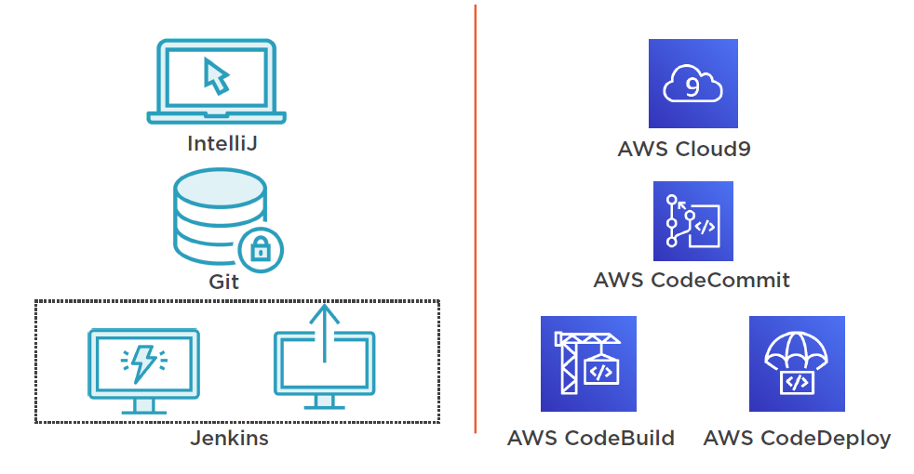
Infrastructure Transformation

Slide 8






Developer tools
AWS CodeStar
Source code
Build code
Deploy
Test code
Monitor
Develop Code
AWS Cloud9 IDE
AWS CodeCommit
AWS CodeBuild
Customer’s favorite tools
AWS CodeDeploy
AWS X-Ray
Amazon CloudWatch
AWS CodePipeline

Slide 9
Code Star
AWS CodeStar enables you to quickly develop, build, and deploy applications on AWS
Teams –manage users, permissions, and roles
Projects –create and manage applications
Integrations –Cloud9 IDE, GitHub, and Jira
Manage –centralized control for source control, build and deploy
AWS CodeStar

Slide 10
Code Star
Project Template Application Categories
Web application
Web service
Alexa skill
Static website
AWS Config rule
Project Template Programming
Languages
C#
Go
HTML.5
Java
Node.js
PHP
Python
Ruby
Project Roles
Owner
Contributor
Viewer
Project Template AWS Services
AWS Elastic Beanstalk
Amazon EC2
AWS Lambda

Slide 11
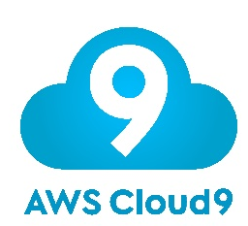
Cloud 9
AWS Cloud9 is a cloud-based integrated development environment (IDE)
Code with just a browser
Includes a code editor, debugger, and terminal
Share your development environment with your team
Work from anywhere using an internet-connected Device

Slide 12
Code commit
AWS CodeCommit is a fully-managed source control service that hosts secure Git-based repositories
Highly available, scalable, and secured
No size limits
Collaboration with other users
Integrate with other AWS services
Interact using familiar git commands
AWS CodeCommit

Slide 13
Code Build
AWS CodeBuild is a fully managed continuous integration service that compiles source code, runs tests, and produces software packages that are ready to deploy
Fully managed build service
Elastic scaling
Pay only for build time used
CLI and API driven
Define builds as code
Tightly knit AWS integrations
AWS CodeBuild

Slide 14
Code deploy
AWS CodeDeploy is a fully managed deployment service that automates software deployments to a variety of compute services such as Amazon EC2, AWS Fargate, AWS Lambda, and your on-premises servers.
Automate your deployments
Fully managed serverless service
Free within AWS
Centralize control
Versatile
AWS CodeDeploy

Slide 15

Blue/Green Deployment
“Blue”
(Existing production environment)
“Green”
(parallel environment running a different version of the application)
“Deployment”
(ability to switch traffic between the two environments)
App component, app server, and microservice.
DNS, load balancer, Amazon EC2 Auto Scaling

Slide 16
Code Pipeline
AWS CodePipeline is a fully managed continuous delivery service that helps you automate your release pipelines for fast and reliable application and infrastructure updates.
Automated CI service
Workflow definition
Triggered from source control
Low barrier to entry for AWS teams
Easy setup for AWS applications
AWS CodePipeline

Slide 17
xray
AWS X-Ray helps developers analyze and debug production, distributed applications, such as those built using a microservices architecture
Helps developers analyze and debug production, distributed applications
Create a service map
Identify errors and bugs
Identify performance bottlenecks
Build your own analysis and visualization applications
AWS X-Ray

Slide 18
AWS Elastic Beanstalk
Elastic Beanstalk automatically handles the deployment
Applications running in EBS can easily scale up and down.
It is one of the fastest and simplest way to deploy applications in AWS.
It is integrated with Cloud watch and X-Ray for monitoring and metrics.
It also provisions the underlying resources for application deployment.
Application code
Configuration
Environment Name
Domain Name
VPC
Database
Platform
(Go, Java, .NET, Node.js, PHP, Python, Ruby, and Docker)
Web server
Worker
or

Slide 19
AWS CloudFormation
AWS CloudFormation users can easily create and manage a collection of related AWS resources.
CloudFormation allows you to use a single JSON/YAML file to model and provision all the infrastructure resources needed for your applications across all regions and accounts.
It is available at no additional charge and you only pay for the resources needed to run your applications
Things can be automated easily in CloudFormation so it requires less time and effort.
Major Concepts of CloudFormation
Template: It is a YAML/JSON format text based file which describes the set up. It is being defined initially and then users can make changes to it for later updates.
Stack: It is the implementation of the template. When users upload their stack to AWS ,it will turn into the infrastructure user requested. All the resources can be created, updated, deleted by creating, updating and deleting the stacks.
Changesets: Change set allows users to see the impact of changes on running resources before implementing them.

Slide 20
AWS Cloudformation
Create/update/delete AWS resources
AWS CloudFormation Template
Create/update/delete
Stack

Slide 21
Structure of a cloud formation template
Parameters
Mappings
Resources
◆ AWS::EC2::Instance
Properties/UserData Metadata/AWS::CloudFormation::Init
▪ Packages
▪ Groups
▪ Users
▪ Sources
▪ Files
▪ Commands
▪ Services
AWS::CloudFormation::WaitCondition
▪ DependsOn: EC2 Instance
AWS::CloudFormation::WaitConditionHandle
Outputs
Parameters: Inputs into template as Key and value at runtime
Mappings: Static variables used to refer the string
Resources: AWS objects that to create (EC2, S3 ,etc.,)
Init: used to deploy applications at startup
WaitCondition: Signal from instance that Init (user data)
has completed running
Outputs: Values of custom resources return by template

Slide 22










Serverless Platform
Compute
APIProxy
Storage
Database
AWS Lambda
Amazon API Gateway
Amazon S3
Amazon DynamoDB
Interprocess Messaging
Orchestration
Analytics
Developer Tools
Amazon SNS and
Amazon SQS
AWS Step Functions
Amazon Kinesis
Amazon Athena
Tooling

Slide 23
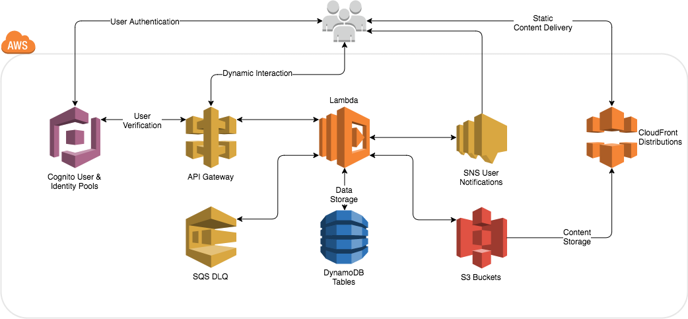
Serverless Architecture
https://github.com/awslabs/serverless-application-model

Slide 24
Sample Questions
A team of Developers have been assigned to a new project. The team will be collaborating on the
development and delivery of a new application and need a centralized private repository for managing
source code. The repository should support updates from multiple sources. Which AWS service should the
development team use?
A.AWS CodeCommit
B.AWS CodeBuild
C.AWS CodeDeploy
D.AWS CodePipeline

Slide 25
Sample Questions
A team of Developers have been assigned to a new project. The team will be collaborating on the
development and delivery of a new application and need a centralized private repository for managing
source code. The repository should support updates from multiple sources. Which AWS service should the
development team use?
A.AWS CodeCommit
B.AWS CodeBuild
C.AWS CodeDeploy
D.AWS CodePipeline

Slide 26
Sample Questions
A Development team have moved their continuous integration and delivery (CI/CD) pipeline into the AWS
Cloud. The team is leveraging AWS CodeCommit for management of source code. The team need to compile
their source code, run tests, and produce software packages that are ready for deployment. Which AWS
service can deliver these outcomes?
A.AWS CodePipeline
B.AWS CodeCommit
C.AWS CodeBuild
D.AWS Cloud9

Slide 27
Sample Questions
A Development team have moved their continuous integration and delivery (CI/CD) pipeline into the AWS
Cloud. The team is leveraging AWS CodeCommit for management of source code. The team need to compile
their source code, run tests, and produce software packages that are ready for deployment. Which AWS
service can deliver these outcomes?
A.AWS CodePipeline
B.AWS CodeCommit
C.AWS CodeBuild
D.AWS Cloud9

Slide 28
Sample Questions
A Developer has joined a team and needs to connect to the AWS CodeCommit repository using SSH. What
should the Developer do to configure access using Git?
A.On the Developer’s IAM account, under security credentials, choose to create HTTPS Git credentials for AWS
CodeCommit
B.On the Developer’s IAM account, under security credentials, choose to create an access key and secret ID
C.Create an account on Github and user those login credentials to login to AWS CodeCommit
D.Generate an SSH public and private key. Upload the public key to the Developer’s IAM account

Slide 29
Sample Questions
A Developer has joined a team and needs to connect to the AWS CodeCommit repository using SSH. What
should the Developer do to configure access using Git?
A.On the Developer’s IAM account, under security credentials, choose to create HTTPS Git credentials for AWS
CodeCommit
B.On the Developer’s IAM account, under security credentials, choose to create an access key and secret ID
C.Create an account on Github and user those login credentials to login to AWS CodeCommit
D.Generate an SSH public and private key. Upload the public key to the Developer’s IAM account

Slide 30
Sample Questions
A Developer needs to access AWS CodeCommit over SSH. The Developer needs to create/delete branches. Which specific IAM permissions need to be added based on the principle of least privilege?
A.“codecommit:CreateBranch” and “codecommit:DeleteBranch”
B.“codecommit:Put*:”
C.“codecommit:Update*”
D.“codecommit:*”

Slide 31
Sample Questions
A Developer needs to access AWS CodeCommit over SSH. The Developer needs to create/delete branches. Which specific IAM permissions need to be added based on the principle of least privilege?
A.“codecommit:CreateBranch” and “codecommit:DeleteBranch”
B.“codecommit:Put*:”
C.“codecommit:Update*”
D.“codecommit:*”

Slide 32
Sample Questions
A Developer is creating an AWS Lambda function that generates a new file each time it runs. Each new file
must be checked into an AWS CodeCommit repository hosted in the same AWS account. How should the
Developer accomplish this?
A.When the Lambda function starts, use the Git CLI to clone the repository. Check the new file into the cloned
repository and push the change
B.After the new file is created in Lambda, use cURL to invoke the CodeCommit API. Send the file to the
repository
C.Use an AWS SDK to instantiate a CodeCommit client. Invoke the put_file method to add the file to the
repository
D.Upload the new file to an Amazon S3 bucket. Create an AWS Step Function to accept S3 events. In the Step
Function, add the new file to the repository

Slide 33
Sample Questions
A Developer is creating an AWS Lambda function that generates a new file each time it runs. Each new file
must be checked into an AWS CodeCommit repository hosted in the same AWS account. How should the
Developer accomplish this?
A.When the Lambda function starts, use the Git CLI to clone the repository. Check the new file into the cloned
repository and push the change
B.After the new file is created in Lambda, use cURL to invoke the CodeCommit API. Send the file to the
repository
C.Use an AWS SDK to instantiate a CodeCommit client. Invoke the put_file method to add the file to the
repository
D.Upload the new file to an Amazon S3 bucket. Create an AWS Step Function to accept S3 events. In the Step
Function, add the new file to the repository

Slide 34
Sample Questions
A serverless application composed of multiple Lambda functions has been deployed. A developer is setting
up AWS CodeDeploy to manage the deployment of code updates. The developer would like a 10% of the
traffic to be shifted to the new version in equal increments, 10 minutes apart. Which setting should be
chosen for configuring how traffic is shifted?
A.Canary
B.Linear
C.All-at-once
D.Blue/green

Slide 35
Sample Questions
A serverless application composed of multiple Lambda functions has been deployed. A developer is setting
up AWS CodeDeploy to manage the deployment of code updates. The developer would like a 10% of the
traffic to be shifted to the new version in equal increments, 10 minutes apart. Which setting should be
chosen for configuring how traffic is shifted?
A.Canary
B.Linear
C.All-at-once
D.Blue/green

Slide 36
Sample Questions
A Developer needs to update an Amazon ECS application that was deployed using AWS CodeDeploy. What
file does the Developer need to update to push the change through CodeDeploy?
A.dockerrun.aws.json
B.buildspec.yml
C.appspec.yml
D.ebextensions.config

Slide 37
Sample Questions
A Developer needs to update an Amazon ECS application that was deployed using AWS CodeDeploy. What
file does the Developer need to update to push the change through CodeDeploy?
A.dockerrun.aws.json
B.buildspec.yml
C.appspec.yml
D.ebextensions.config

Slide 38
Sample Questions
A Developer is deploying an Amazon EC2 update using AWS CodeDeploy. In the appspec.yml file, which of
the following is a valid structure for the order of hooks that should be specified?
A.BeforeInstall > AfterInstall > AfterAllowTestTraffic > BeforeAllowTraffic > AfterAllowTraffic
B.BeforeInstall > AfterInstall > ApplicationStart > ValidateService
C.BeforeAllowTraffic > AfterAllowTraffic
D.BeforeBlockTraffic > AfterBlockTraffic > BeforeAllowTraffic > AfterAllowTraffic

Slide 39
Sample Questions
A Developer is deploying an Amazon EC2 update using AWS CodeDeploy. In the appspec.yml file, which of
the following is a valid structure for the order of hooks that should be specified?
A.BeforeInstall > AfterInstall > AfterAllowTestTraffic > BeforeAllowTraffic > AfterAllowTraffic
B.BeforeInstall > AfterInstall > ApplicationStart > ValidateService
C.BeforeAllowTraffic > AfterAllowTraffic
D.BeforeBlockTraffic > AfterBlockTraffic > BeforeAllowTraffic > AfterAllowTraffic

Slide 40
Sample Questions
An application will be hosted on the AWS Cloud. Developers will be using an Agile software development
methodology with regular updates deployed through a continuous integration and delivery (CI/CD) model.
Which AWS service can assist the Developers with automating the build, test, and deploy phases of the
release process every time there is a code change?
A.AWS CodeBuild
B.AWS CloudFormation
C.AWS Elastic Beanstalk
D.AWS CodePipeline

Slide 41
Sample Questions
An application will be hosted on the AWS Cloud. Developers will be using an Agile software development
methodology with regular updates deployed through a continuous integration and delivery (CI/CD) model.
Which AWS service can assist the Developers with automating the build, test, and deploy phases of the
release process every time there is a code change?
A.AWS CodeBuild
B.AWS CloudFormation
C.AWS Elastic Beanstalk
D.AWS CodePipeline

Slide 42
Sample Questions
A team of Developers need to deploy a website for a development environment. The team do not want to
manage the infrastructure and just need to upload Node.js code to the instances. Which AWS service should Developers do?
A.Create an AWS CloudFormation template
B.Create an AWS Elastic Beanstalk environment
C.Create an AWS Lambda package
D.Launch an Auto Scaling group of Amazon EC2 instances

Slide 43
Sample Questions
A team of Developers need to deploy a website for a development environment. The team do not want to
manage the infrastructure and just need to upload Node.js code to the instances. Which AWS service should Developers do?
A.Create an AWS CloudFormation template
B.Create an AWS Elastic Beanstalk environment
C.Create an AWS Lambda package
D.Launch an Auto Scaling group of Amazon EC2 instances

Slide 44
Sample Questions
You’re developing an AWS Lambda function that is interacting with a DynamoDB table. The function was working well, but now is giving the results with a time delay. You need to debug the code to understand where the bottleneck is which is causing the performance issue. Which of the following is the ideal way to debug the code?
a. Use Log statements in the code to detect the delay
b. Use Cloudwatch logs to detect where the delay could be
c. Look at the throttling errors in Cloudwatch metrics
d. Use AWS X-Ray to see where the downstream delay could be

Slide 45
Sample Questions
You’re developing an AWS Lambda function that is interacting with a DynamoDB table. The function was working well, but now is giving the results with a time delay. You need to debug the code to understand where the bottleneck is which is causing the performance issue. Which of the following is the ideal way to debug the code?
a. Use Log statements in the code to detect the delay
b. Use Cloudwatch logs to detect where the delay could be
c. Look at the throttling errors in Cloudwatch metrics
d. Use AWS X-Ray to see where the downstream delay could be

Slide 46
Sample Questions
You have created the stages in CodePipeline: What happens if there is a failure detected in the "Build" stage?
a. A rollback will happen at the "Source" stage.
b. The "Build" step will be attempted again.
c. The "Build" step will be skipped and the "Staging" step will start.
d. The entire process will halt.

Slide 47
Sample Questions
You have created the stages in CodePipeline: What happens if there is a failure detected in the "Build" stage?
a. A rollback will happen at the "Source" stage.
b. The "Build" step will be attempted again.
c. The "Build" step will be skipped and the "Staging" step will start.
d. The entire process will halt.

Slide 48
Sample Questions
You have created the stages in CodePipeline: What happens if there is a failure detected in the "Build" stage?
a. A rollback will happen at the "Source" stage.
b. The "Build" step will be attempted again.
c. The "Build" step will be skipped and the "Staging" step will start.
d. The entire process will halt.

Slide 49
Sample Questions
A Developer is creating multiple AWS Lambda functions that will be using an external library that is not
included in the standard Lambda libraries. What is the BEST way to make these libraries available to the
functions?
A.Include the external library with the function code
B.Create a deployment package that includes the external library
C.Store the files in Amazon S3 and reference them from your function code
D.Create a layer in Lambda that includes the external library

Slide 50
Sample Questions
A Developer is creating multiple AWS Lambda functions that will be using an external library that is not
included in the standard Lambda libraries. What is the BEST way to make these libraries available to the
functions?
A.Include the external library with the function code
B.Create a deployment package that includes the external library
C.Store the files in Amazon S3 and reference them from your function code
D.Create a layer in Lambda that includes the external library

Slide 51
Sample Questions
A Developer has been asked to create an AWS Elastic Beanstalk environment for a production web application which needs to handle thousands of requests. Currently, the dev environment is running on a t1.micro instance. What is the best way for the developer to provision a new production environment with a m4.large instance instead of a t1.micro?
a. Use CloudFormation to migrate the Amazon EC2 instance type from t1.micro to m4.large.
b. Create a new configuration file with the instance type as m4.large and reference this file when provisioning the new environment.
c. Provision a m4.large instance directly in the dev environment and deploy to the new production environment.
d. Change the instance type value in the configurations file to m4.large by using the update autoscaling group CLI command.

Slide 52
Sample Questions
A Developer has been asked to create an AWS Elastic Beanstalk environment for a production web application which needs to handle thousands of requests. Currently, the dev environment is running on a t1.micro instance. What is the best way for the developer to provision a new production environment with a m4.large instance instead of a t1.micro?
a. Use CloudFormation to migrate the Amazon EC2 instance type from t1.micro to m4.large.
b. Create a new configuration file with the instance type as m4.large and reference this file when provisioning the new environment.
c. Provision a m4.large instance directly in the dev environment and deploy to the new production environment.
d. Change the instance type value in the configurations file to m4.large by using the update autoscaling group CLI command.

Slide 53
Sample Questions
A Developer has been asked to create an AWS Elastic Beanstalk environment for a production web application which needs to handle thousands of requests. Currently, the dev environment is running on a t1.micro instance. What is the best way for the developer to provision a new production environment with a m4.large instance instead of a t1.micro?
a. Use CloudFormation to migrate the Amazon EC2 instance type from t1.micro to m4.large.
b. Create a new configuration file with the instance type as m4.large and reference this file when provisioning the new environment.
c. Provision a m4.large instance directly in the dev environment and deploy to the new production environment.
d. Change the instance type value in the configurations file to m4.large by using the update autoscaling group CLI command.

Slide 54
Sample Questions
An organization is using AWS Elastic Beanstalk for a web application. The Developer needs to configure the Elastic Beanstalk environment with deployment methods that will create new instances and deploy code to those instances. Which methods will deploy code ONLY to new instances? Choose 2 answers from the options given below.
a. All at once deployment
b. Immutable deployment
c. Rolling deployment
d. Linear deployment
e. Blue/Green deployment

Slide 55
Sample Questions
An organization is using AWS Elastic Beanstalk for a web application. The Developer needs to configure the Elastic Beanstalk environment with deployment methods that will create new instances and deploy code to those instances. Which methods will deploy code ONLY to new instances? Choose 2 answers from the options given below.
a. All at once deployment
b. Immutable deployment
c. Rolling deployment
d. Linear deployment
e. Blue/Green deployment

Slide 56
Sample Questions
An organization is using AWS Elastic Beanstalk for a web application. The Developer needs to configure the Elastic Beanstalk environment with deployment methods that will create new instances and deploy code to those instances. Which methods will deploy code ONLY to new instances? Choose 2 answers from the options given below.
a. All at once deployment
b. Immutable deployment
c. Rolling deployment
d. Linear deployment
e. Blue/Green deployment

Slide 57
Sample Questions
Your team has an application deployed using the Elastic Beanstalk service. A Web environment has been configured for the production environment. There is now a requirement to perform a Blue Green deployment for a new version of the application. How can you achieve this?
a. Create a new application and swap the application environments.
b. Create a new application version and upload the new application version
c. Create a new environment in the application with the updated application version and perform a swap
d. Create a new environment in the application and Load the configuration of an existing environment

Slide 58
Sample Questions
Your team has an application deployed using the Elastic Beanstalk service. A Web environment has been configured for the production environment. There is now a requirement to perform a Blue Green deployment for a new version of the application. How can you achieve this?
a. Create a new application and swap the application environments.
b. Create a new application version and upload the new application version
c. Create a new environment in the application with the updated application version and perform a swap
d. Create a new environment in the application and Load the configuration of an existing environment

Slide 59
Sample Questions
Your team has an application deployed using the Elastic Beanstalk service. A Web environment has been configured for the production environment. There is now a requirement to perform a Blue Green deployment for a new version of the application. How can you achieve this?
a. Create a new application and swap the application environments.
b. Create a new application version and upload the new application version
c. Create a new environment in the application with the updated application version and perform a swap
d. Create a new environment in the application and Load the configuration of an existing environment

Slide 60
Sample Questions
You’re in charge for creating a cloudformation template. This template needs to create resources for multiple types of environment. The template needs to be flexible so that it can create resources based on the type of environment. How can you achieve this? Choose 2 answers from the options given below.
a. Create an Input Parameter to take in the type of environment.
b. Use the Outputs section to define the type of environment
c. Use the Custom Resources feature to create resources based on the type of environment
d. Use the Conditions section to create resources based on the type of environment

Slide 61
Sample Questions
You’re in charge for creating a cloudformation template. This template needs to create resources for multiple types of environment. The template needs to be flexible so that it can create resources based on the type of environment. How can you achieve this? Choose 2 answers from the options given below.
a. Create an Input Parameter to take in the type of environment.
b. Use the Outputs section to define the type of environment
c. Use the Custom Resources feature to create resources based on the type of environment
d. Use the Conditions section to create resources based on the type of environment

Slide 62
Sample Questions
You’re in charge for creating a cloudformation template. This template needs to create resources for multiple types of environment. The template needs to be flexible so that it can create resources based on the type of environment. How can you achieve this? Choose 2 answers from the options given below.
a. Create an Input Parameter to take in the type of environment.
b. Use the Outputs section to define the type of environment
c. Use the Custom Resources feature to create resources based on the type of environment
d. Use the Conditions section to create resources based on the type of environment

Slide 63
Sample Questions
Which API call is used to list all resources that belong to a CloudFormation Stack? Choose an answer from the options below
a. DescribeStackResources
b. describe-stacks
c. ListStackResources
d. GetTemplate

Slide 64
Sample Questions
Which API call is used to list all resources that belong to a CloudFormation Stack? Choose an answer from the options below
a. DescribeStackResources
b. describe-stacks
c. ListStackResources
d. GetTemplate

Slide 65
Sample Questions
Which API call is used to list all resources that belong to a CloudFormation Stack? Choose an answer from the options below
a. DescribeStackResources
b. describe-stacks
c. ListStackResources
d. GetTemplate

Slide 66
Sample Questions
The following code snippet is the resources section of a CloudFormation template that you have written.
"Resources" : {
"EC2Instance" : {
"Type" : "AWS::EC2::Instance",
"Properties" : {
"InstanceType" : { "Ref" : "InstanceType" },
"SecurityGroups" : [ { "Ref" : "InstanceSecurityGroup" } ],
"KeyName" : { "Ref" : "KeyName" },
"ImageId" : { "Fn::FindInMap" : [ "AWSRegionArch2AMI", { "Ref" : "AWS::Region" },
{ "Fn::FindInMap" : [ "AWSInstanceType2Arch", { "Ref" : "InstanceType" }, "Arch" ] }
]
} } },
You have used the reference function to define your instance type as follows.
"InstanceType" : { "Ref" : "InstanceType" },
The referencing function is referencing the instance type. Where is this value most likely coming from?
a. From the mappings section of your CloudFormation template.
b. From the second line of this resources section.
c. From the conditions section of your CloudFormation template.
d. From the parameters section of your CloudFormation template.

Slide 67
Sample Questions
The following code snippet is the resources section of a CloudFormation template that you have written.
"Resources" : {
"EC2Instance" : {
"Type" : "AWS::EC2::Instance",
"Properties" : {
"InstanceType" : { "Ref" : "InstanceType" },
"SecurityGroups" : [ { "Ref" : "InstanceSecurityGroup" } ],
"KeyName" : { "Ref" : "KeyName" },
"ImageId" : { "Fn::FindInMap" : [ "AWSRegionArch2AMI", { "Ref" : "AWS::Region" },
{ "Fn::FindInMap" : [ "AWSInstanceType2Arch", { "Ref" : "InstanceType" }, "Arch" ] }
]
} } },
You have used the reference function to define your instance type as follows.
"InstanceType" : { "Ref" : "InstanceType" },
The referencing function is referencing the instance type. Where is this value most likely coming from?
a. From the mappings section of your CloudFormation template.
b. From the second line of this resources section.
c. From the conditions section of your CloudFormation template.
d. From the parameters section of your CloudFormation template.

Slide 68
Sample Questions
The following code snippet is the resources section of a CloudFormation template that you have written.
"Resources" : {
"EC2Instance" : {
"Type" : "AWS::EC2::Instance",
"Properties" : {
"InstanceType" : { "Ref" : "InstanceType" },
"SecurityGroups" : [ { "Ref" : "InstanceSecurityGroup" } ],
"KeyName" : { "Ref" : "KeyName" },
"ImageId" : { "Fn::FindInMap" : [ "AWSRegionArch2AMI", { "Ref" : "AWS::Region" },
{ "Fn::FindInMap" : [ "AWSInstanceType2Arch", { "Ref" : "InstanceType" }, "Arch" ] }
]
} } },
You have used the reference function to define your instance type as follows.
"InstanceType" : { "Ref" : "InstanceType" },
The referencing function is referencing the instance type. Where is this value most likely coming from?
a. From the mappings section of your CloudFormation template.
b. From the second line of this resources section.
c. From the conditions section of your CloudFormation template.
d. From the parameters section of your CloudFormation template.

Slide 69
Sample Questions
You are using AWS SAM templates to deploy a serverless application. Which of the following resource will embed nested application from Amazon S3 buckets?
a. AWS::Serverless::Api
b. AWS::Serverless::Application
c. AWS::Serverless::LayerVersion
d. AWS::Serverless::Function

Slide 70
Sample Questions
You are using AWS SAM templates to deploy a serverless application. Which of the following resource will embed nested application from Amazon S3 buckets?
a. AWS::Serverless::Api
b. AWS::Serverless::Application
c. AWS::Serverless::LayerVersion
d. AWS::Serverless::Function

Slide 71
Sample Questions
You are using AWS SAM templates to deploy a serverless application. Which of the following resource will embed nested application from Amazon S3 buckets?
a. AWS::Serverless::Api
b. AWS::Serverless::Application
c. AWS::Serverless::LayerVersion
d. AWS::Serverless::Function

Slide 72
Sample Questions
A developer has recently deployed an AWS Lambda function that computes a Fibonacci sequence using recursive Lambda invocations. A pre-defined AWS IAM policy is being used for this function, and only the required dependencies were packaged. A few days after deployment, the Lambda function is being throttled. What should the Developer have done to prevent this, according to best practices?
a. Avoid the use of recursion
b. Request a concurrency service limit increase
c. Increase the memory allocation range.
d. Use more restrictive IAM policies

Slide 73
Sample Questions
A developer has recently deployed an AWS Lambda function that computes a Fibonacci sequence using recursive Lambda invocations. A pre-defined AWS IAM policy is being used for this function, and only the required dependencies were packaged. A few days after deployment, the Lambda function is being throttled. What should the Developer have done to prevent this, according to best practices?
a. Avoid the use of recursion
b. Request a concurrency service limit increase
c. Increase the memory allocation range.
d. Use more restrictive IAM policies

Slide 74
Sample Questions
A developer has recently deployed an AWS Lambda function that computes a Fibonacci sequence using recursive Lambda invocations. A pre-defined AWS IAM policy is being used for this function, and only the required dependencies were packaged. A few days after deployment, the Lambda function is being throttled. What should the Developer have done to prevent this, according to best practices?
a. Avoid the use of recursion
b. Request a concurrency service limit increase
c. Increase the memory allocation range.
d. Use more restrictive IAM policies

Slide 75
Sample Questions
An organization deployed their static website on Amazon S3. Now, the Developer has a requirement to serve dynamic content using a serverless solution. Which combination of services should be used to implement a serverless application for the dynamic content? Select 2 answers from the options given below
a. Amazon API Gateway
b. Amazon EC2
c. AWS ECS
d. AWS Lambda
e. Amazon kinesis

Slide 76
Sample Questions
An organization deployed their static website on Amazon S3. Now, the Developer has a requirement to serve dynamic content using a serverless solution. Which combination of services should be used to implement a serverless application for the dynamic content? Select 2 answers from the options given below
a. Amazon API Gateway
b. Amazon EC2
c. AWS ECS
d. AWS Lambda
e. Amazon kinesis

Slide 77
Sample Questions
An organization deployed their static website on Amazon S3. Now, the Developer has a requirement to serve dynamic content using a serverless solution. Which combination of services should be used to implement a serverless application for the dynamic content? Select 2 answers from the options given below
a. Amazon API Gateway
b. Amazon EC2
c. AWS ECS
d. AWS Lambda
e. Amazon kinesis

Slide 78
Happy Learning!!
78

